Slide 1

Bank Marketing Analysis Final Project
Virtual Internship
Apoorv Ajay Thite

Slide 2

Project | Bank Marketing Analysis
Submitted By | Apoorv Ajay Thite
Email | apoorvthite21@gmail.com
Country | United States of America
Specialization | Data Analyst
Internship Batch | LISUM34
Date | 7th August 2024

Slide 3
Agenda
Problem Statement
Data Information
Data Understanding
Exploratory Data Analysis (EDA)
Modeling Technique
Recommendations

Slide 4
Problem Statement
Introduction:
Background:
This analysis focuses on direct marketing campaigns conducted by a Portuguese banking institution.
The primary method of marketing was phone calls, targeting clients for subscriptions to time deposits.
The classification goal is to predict whether a client will subscribe to a term deposit based on historical data.
Objective:
To optimize marketing resources and strategies by identifying potential subscribers.
Improve campaign effectiveness through data-driven insights.
Enhance customer engagement by targeting the right clients with the right offers.
Direct marketing campaigns require significant resources, and their effectiveness often depends on accurate targeting.
By predicting which clients are likely to subscribe to a term deposit, the bank can allocate its resources more efficiently.
The goal is to leverage data to create a predictive model that helps in making informed decisions for future campaigns.
Description:

Slide 5
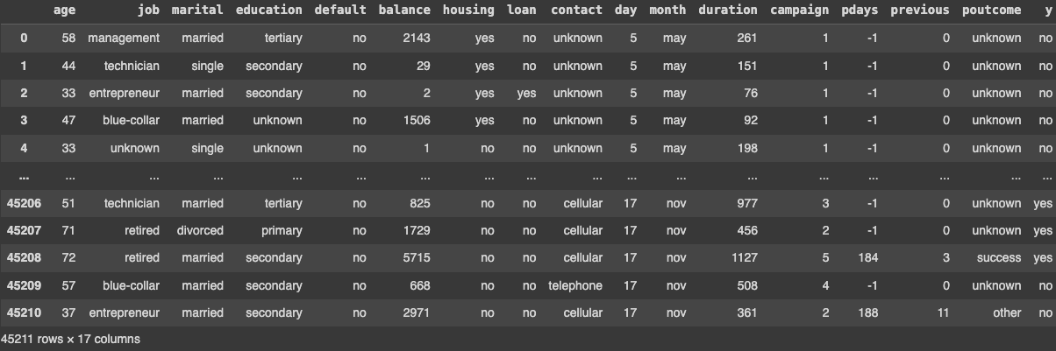
Data Information
Data Source:
The dataset contains records of direct marketing campaigns conducted by a Portuguese bank.
A total of 45,211 entries with 17 features each, including both numerical and categorical variables.
Key Features:
Age: Client’s age.
Job: Type of job the client holds.
Marital: Marital status.
Education: Education level.
Balance: Account balance.
Previous Campaign Data: Includes variables like the outcome of previous campaigns, contact duration, and number of contacts.
Target Variable:
y: Whether the client subscribed to a term deposit (yes/no).

Slide 6
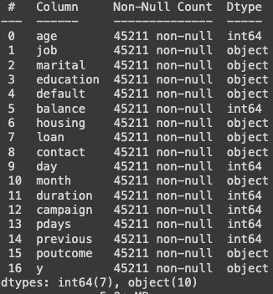
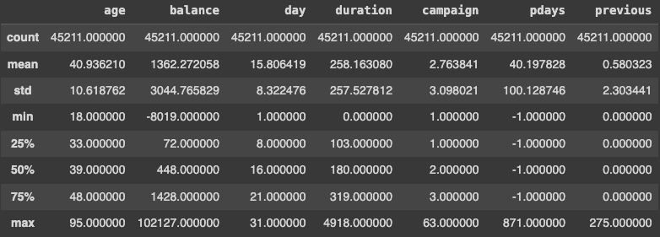
Data Information

Slide 7
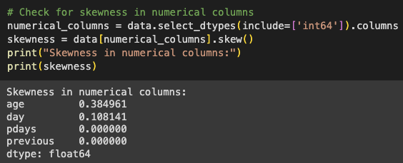
Data Intake and Preparation
Data Intake Report:
Completeness: The dataset was found to be complete with no missing values.
Data Types: The dataset includes both numerical (e.g., age, balance) and categorical variables (e.g., job, marital status).
Outlier Detection: Numerical variables were checked for outliers, and appropriate transformations were considered.
Data Cleaning:
Ensured all categorical variables had consistent formatting.
Addressed any anomalies in the dataset.
Prepared the data for exploratory analysis by encoding categorical variables where necessary.

Slide 8
Exploratory Data Analysis
(EDA)
Purpose and Importance of EDA:
Exploratory Data Analysis (EDA) is a critical step in the data science process, serving as the foundation for building robust models and deriving actionable insights.
EDA helps to understand the underlying patterns, trends, and relationships within the dataset, allowing us to make informed decisions about feature selection, data transformation, and model choice.
Through EDA, we can identify potential issues such as outliers, missing values, or incorrect data types that might affect the performance of our predictive models.
Key Objectives of EDA:
Data Understanding: Gain a deep understanding of the dataset's structure, including the distribution of individual features, and the relationships between features and the target variable.
Feature Analysis: Identify the most influential features that contribute to the prediction of term deposit subscriptions.
Data Cleaning: Detect and handle any anomalies, such as missing values, outliers, or inconsistencies, to ensure data quality.
Hypothesis Generation: Formulate hypotheses about potential factors that influence the target variable (e.g., Does age influence the likelihood of subscription? How does account balance affect decision-making?).

Slide 9
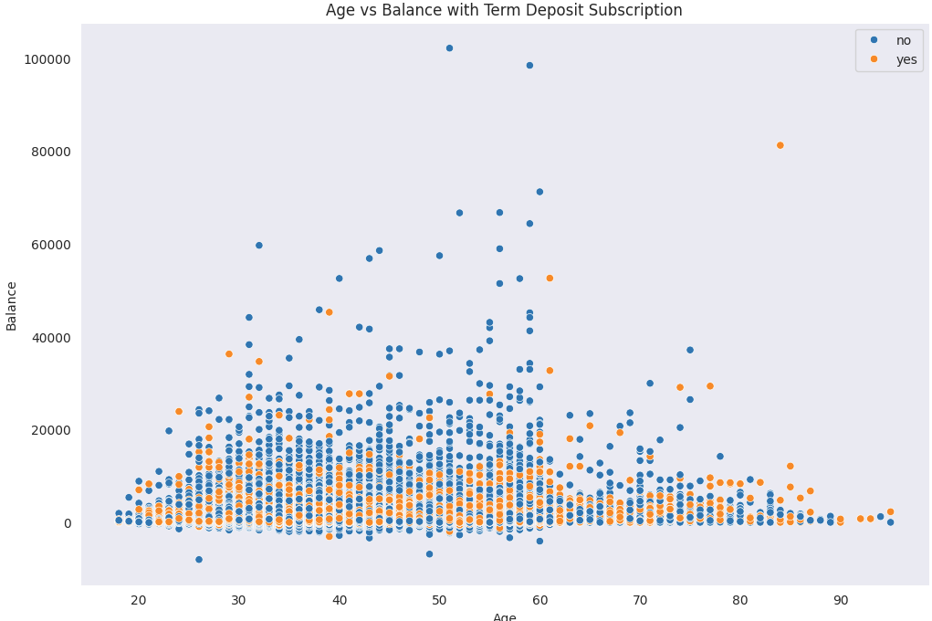
EDA
1. Age vs Balance with Term Deposit Subscription
This scatter plot visualizes the relationship between age and account balance of clients, with an additional dimension of whether they subscribed to a term deposit (indicated by different colors). Clients span a wide range of ages, from about 20 to over 90 years old, with a dense concentration in the 30-60 age range. Most clients, regardless of age, have lower account balances, with a noticeable increase in balance variability among clients in their 30s to 60s.
The orange dots, representing clients who subscribed to a term deposit, are scattered across all age groups but are more prominent in clients with higher balances. This indicates that wealthier clients, regardless of age, may be more inclined to invest in long-term savings products like term deposits. The bank could potentially increase term deposit subscriptions by focusing on clients with higher balances across all age groups, especially those in the 30-60 age bracket.

Slide 10
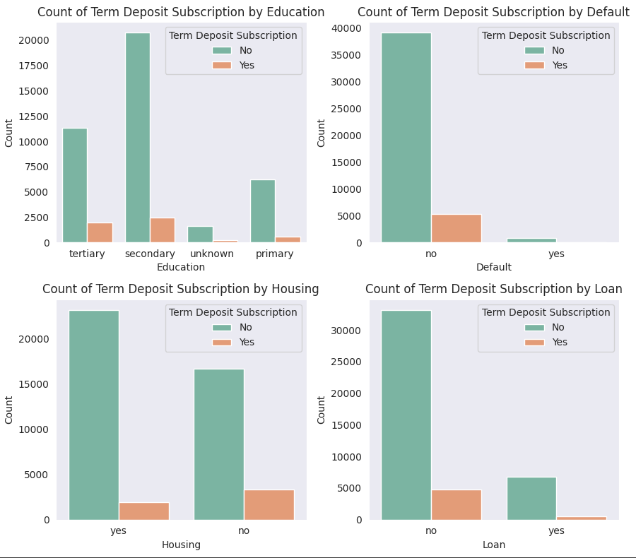
EDA
2. Education, Default, Housing, Loan
These bar plots show the relationship between term deposit subscriptions and four different features: Education: Clients with tertiary education are more likely to subscribe to a term deposit compared to those with primary or secondary education, although the majority still do not subscribe. Default: Clients with no credit in default are more likely to subscribe to a term deposit. Those with a default status rarely subscribe. Housing Loan: Clients without a housing loan show a higher likelihood of subscribing compared to those with a housing loan. Personal Loan: Clients without a personal loan are more likely to subscribe to a term deposit than those with a loan.
Overall, the plots suggest that higher education, lack of default, and absence of loans (both housing and personal) are associated with a higher likelihood of term deposit subscription.

Slide 11
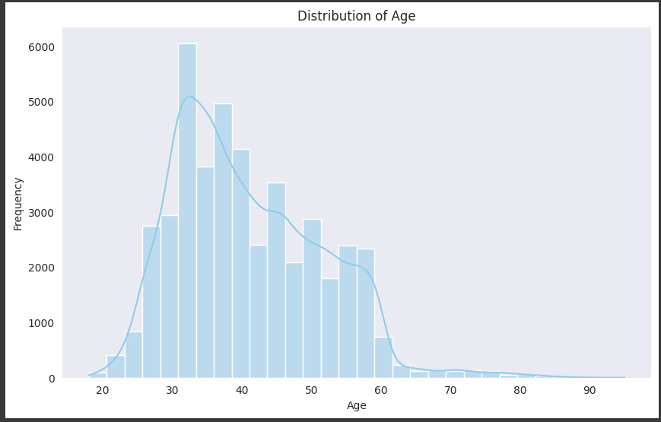
EDA
3. Age distribution among clients
This histogram with a density plot shows the distribution of age among the clients in the dataset. The age distribution is right-skewed, with most clients concentrated in the 30 to 40 age range.
The frequency decreases gradually as age increases, with very few clients above the age of 60. This suggests that the bank’s customer base is predominantly middle-aged, which is typically a financially active period when individuals might be more inclined to consider long-term savings products such as term deposits.
Understanding this age distribution can help tailor marketing strategies to target the most prominent age groups effectively.
Overall, this age distribution analysis highlights the importance of focusing on the 30 to 50 age group while also considering strategies to engage with both younger clients who are just beginning their financial journey and older clients who may have different banking needs.

Slide 12
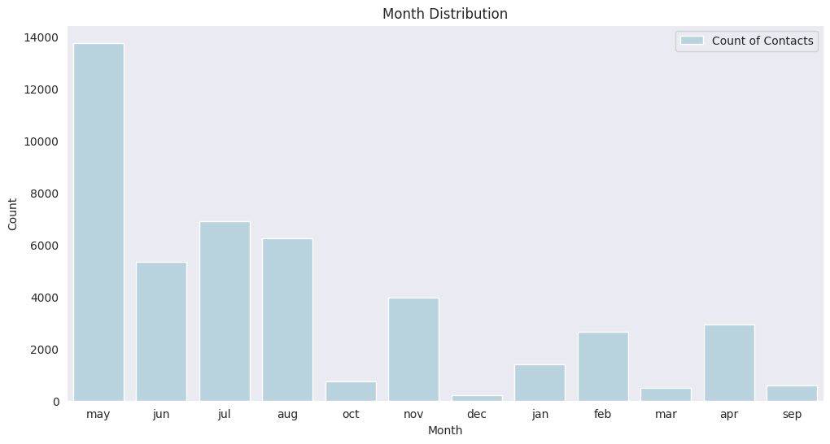
EDA
4. Distribution of Cliient Contacts through the year
This bar chart shows the distribution of client contacts throughout the year, revealing significant seasonal trends in the bank’s marketing efforts. May is the peak month, with the highest number of contacts, likely due to targeted marketing campaigns or end-of-quarter initiatives.
The summer months of June, July, and August maintain a moderate level of activity, while contact frequency drops sharply from September through February, with the lowest point in December. This suggests that the bank’s marketing efforts are concentrated in specific periods, particularly in the spring and early summer, with reduced activity during the fall and winter months.
These patterns indicate that the bank might benefit from optimizing their campaign strategies during peak periods like May and exploring opportunities to engage customers more effectively during the quieter months, ensuring a more balanced and consistent approach to customer outreach throughout the year.

Slide 13
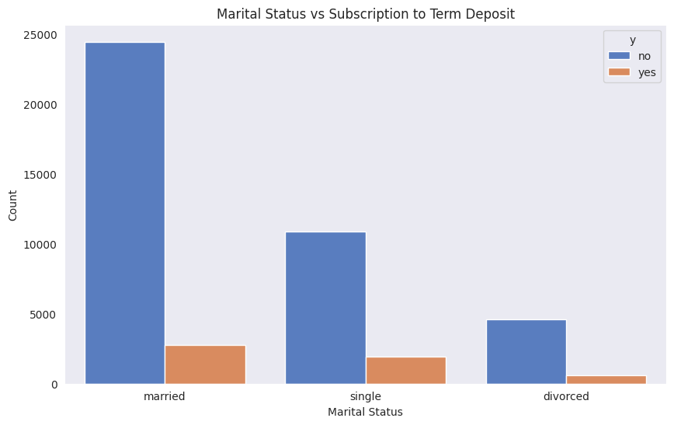
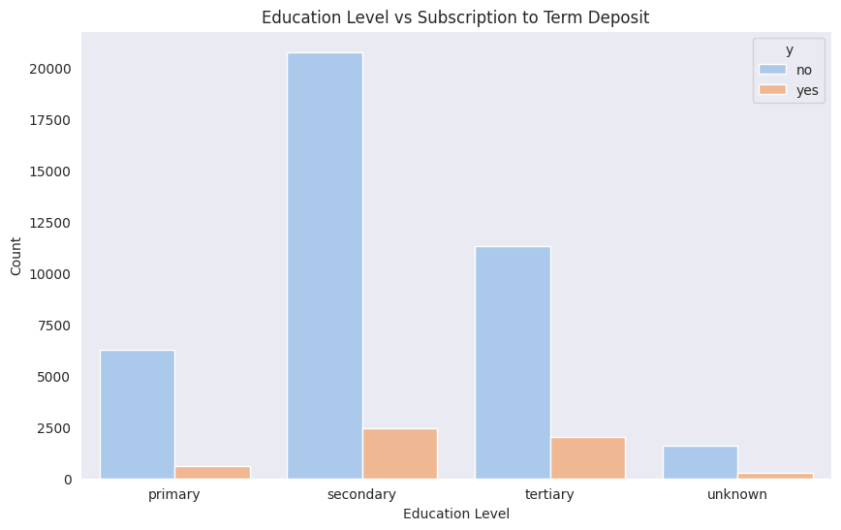
EDA
5. Relationship between marital status and the likelihood of subscribing to a term deposit
This bar chart illustrates the relationship between marital status and the likelihood of subscribing to a term deposit. The data shows that married individuals constitute the largest group among the bank’s clients, followed by single and divorced individuals. However, across all marital statuses, the majority of clients did not subscribe to a term deposit, as indicated by the predominance of the blue bars. Interestingly, while married individuals are the largest group, their rate of subscription is relatively low compared to their overall numbers.
Single individuals also show a low subscription rate, though they make up the second-largest group. Divorced individuals represent the smallest group in terms of both total numbers and subscriptions, but their subscription rate is similarly low.
This bar chart explores the relationship between education level and the likelihood of subscribing to a term deposit. The chart reveals that clients with secondary education make up the largest group, followed by those with tertiary and primary education. However, the majority of clients across all education levels did not subscribe to a term deposit, as indicated by the dominance of the blue bars.
Notably, clients with tertiary education have a slightly higher subscription rate compared to those with primary and secondary education. This suggests that higher education levels might be associated with a greater understanding or interest in financial products like term deposits. However, despite this trend, the overall subscription rates remain low, indicating that education alone is not a strong predictor of whether a client will subscribe.

Slide 14
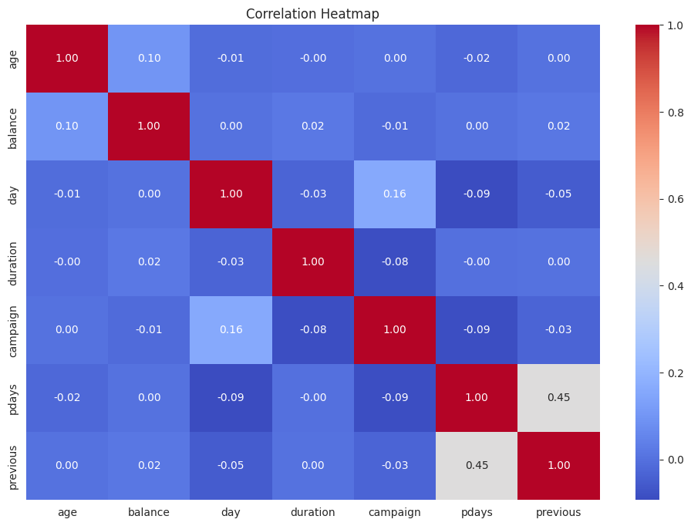
EDA
6. Correlation Matrix
This correlation heatmap reveals the relationships between various numerical features in the dataset. Most features exhibit weak correlations with each other, indicating that they are relatively independent.
The strongest positive correlation is observed between the "previous" and "pdays" features, with a coefficient of 0.45, suggesting that if a client was contacted in a previous campaign, they are more likely to have a recorded number of days since that last contact. Another mild positive correlation exists between "campaign" and "day," indicating a slight relationship between the day of the month and the number of contacts made during the campaign.
The weak correlations among other features, such as "age," "balance," and "duration," suggest that these variables may provide unique, independent information for the predictive model.
This analysis underscores the importance of treating each feature independently while recognizing that certain pairs of variables, like "previous" and "pdays," might offer additional insights when considered together.

Slide 15
Modelling Techniques
Baseline Model - Logistic Regression:
Why: Logistic regression can serve as a strong baseline due to its interpretability and simplicity. It is particularly useful for binary classification tasks like predicting term deposit subscriptions (yes/no). Despite the weak correlations between most features, logistic regression can still provide valuable insights into the influence of individual variables, such as age, education, marital status, and balance, on the target variable.
How: The model can be used to estimate the probability of a client subscribing to a term deposit, with coefficients indicating the direction and magnitude of the impact of each feature. Regularization techniques such as L1 (Lasso) or L2 (Ridge) can be employed to prevent overfitting and to handle the less significant features.
Logistic Regression
Decision Trees
Random Forest
Gradient Boosting Machines
Decision Trees and Random Forests:
Why: Given the weak linear relationships identified in the correlation heatmap, decision trees are ideal for capturing non-linear interactions between variables. A Random Forest model, which is an ensemble of decision trees, can further enhance predictive power by averaging multiple trees to reduce variance and improve generalization.
How: Random Forests can handle the diverse and mostly independent nature of the features by considering different subsets of features at each split. This approach is particularly useful when dealing with categorical variables like education level and marital status, as well as continuous variables like age and balance, without requiring extensive preprocessing. The model can automatically rank features by importance, helping to identify which variables contribute the most to predictions.
Gradient Boosting Machines (GBM):
Why: Gradient Boosting algorithms, including XGBoost, LightGBM, and CatBoost, are powerful for capturing complex patterns and interactions in the data. They are particularly effective in scenarios where the relationship between the input features and the target variable is non-linear, as suggested by the EDA.
How: GBM builds models sequentially, with each new model correcting the errors of the previous one. This technique is highly effective in improving the accuracy of predictions by focusing on the harder-to-predict instances, such as those with specific combinations of features like age, previous campaign interactions (pdays, previous), and education level.

Slide 16
Recommendations
1. Start with a Basic Model
Recommendation: Begin by building a simple model (like logistic regression) to predict which customers are likely to subscribe to a term deposit. This will give us a baseline to compare against more advanced models.
Next Step: Use this model to identify the key factors that influence customer decisions.
2. Enhance with Advanced Models
Recommendation: Implement more sophisticated models like Random Forests and Gradient Boosting to capture complex patterns in the data that the basic model might miss.
Next Step: Experiment with these models to see which one gives the most accurate predictions.
3. Fine-Tune the Models
Recommendation: Adjust the settings (hyperparameters) of the models to optimize their performance and ensure they are as accurate as possible.
Next Step: Test different configurations to find the best setup for our data.
4. Evaluate Model Performance
Recommendation: Look beyond just accuracy. Consider other factors like how well the model predicts true positives (actual subscriptions) versus false positives (incorrect predictions).
Next Step: Analyze results from different angles to ensure we’re getting the most reliable predictions.
5. Address Potential Imbalances
Recommendation: If our data has more customers not subscribing than subscribing, take steps to balance it out so our model doesn’t become biased.
Next Step: Use techniques to adjust for this imbalance and reassess model performance.

Slide 17
Thank You

